Slide 1

FORECASTING BROADWAY SALES
Predicting future sales of Broadway tickets
Team Juno
Praveen Shahani
Gautam Prakriya
Michael Amoah Awuah
Moran Shechnick
Spring 2022 Bootcamp
Notes:
Some statistics of the broadway industry

Slide 2
PROJECT ROADMAP
1
2
3
4
DATA COLLECTION
EXPLORATORY DATA ANALYSIS
DATA VISUALIZATION
DATA FORECASTING
Found and collected Broadway shows and ticket sales data.
Explored and analyzed the data to understand the dataset and outliers.
Visualized data to check trends and seasonality.
Used forecast models LR+ ARIMA(F&DF) + LSTM + MLR + Prophet to predict future trend.

Slide 3
Puzzle: from IDEA TO EXECUTION
STEP 02
Conducted Exploratory Data Analysis to understand the dataset and outliers.
Worked on research questions.
Step 01: Find, web scrape and combine data
Broadway sales
https://www.playbill.com/grosses
Broadway reviews:
https://www.newyorktheatreguide.com/reviews/broadway
Step 02: Exploratory Data Analysis
Described the data and conducted EDA to explore the data and its outliers.
Step 03: Visualization of Data
Visualized the data to check for trends and seasonality.
Step 04: Use the ARIMA,LSTM,MLR, and Prophet predictive models on the dataset
Used LR + ARIMA, LSTM, MLR & Prophet for time-series forecasting of revenue and ticket sales.
STEP 01
Defined the topic, KPI’s and stakeholders
Scraped the web for a number of Broadway data sources from 1985-2020 and combined it .
STEP 03
Visualized data to understand certain aspects of dataset like the nature of audience, percentage capacity and ticket affordability.
Visualized for trends and seasonality.
STEP 04
Fitted predictive models: LR+ARIMA+LSTM+MLR+Prophet to forecast the future values of variables such as ticket sales, audience attendance etc.
Described the nature of the future trajectory.

Slide 4
Introduction
Motivation:
Money for Broadway shows is typically raised by a small group of producers. Besides the initial costs of producing the show, the producers are also responsible for the weekly wages of the cast and crew as well as the rent for the theatre in which the show is played. It typically takes investors 1 year to 18 months to break even. Broadway shows are a high risk/ high reward investments - less than 1 in 5 shows make a profit, however when there is a hit show like Lion King, Phantom of the Opera or Hamilton, the returns are enormous.
Our project predicts how the Broadway industry can maximize profit on ticket sales and theatre attendance.
Stakeholders:
- Primary Stakeholders: Investors and Producers
- Secondary Stakeholders: Theatre owners & managers, Donors and Crew
Main Question:
What are the trends in Broadway show attendance, ticket sales, playing weeks/months and expected profits given historical data of Broadway shows?
Our Approaches:
Trial:
Linear Regression
- 5 Forecast Models:
ARIMA – Forecasting and Dynamic Forecasting
LSTM
Multiple Linear Regression
FB Prophet
(NB: These 5 models were used in order to recommend the best model for time-series forecasting of the data to check for future trends and seasonality.)

Slide 5
Datasets
 | Year | Show_name | Potential_Gross | Difference | Average_ticket | Seats_Sold | Seats_in_theater | Previews | %cap | diff_cap
0 | 09-06-1985 | 42nd Street | 0.0 | 0.00 | 30.42 | 9281 | 1655 | 8 | 70.10 | 0.00
1 | 09-06-1985 | A Chorus Line | 0.0 | 0.00 | 27.25 | 8167 | 1472 | 8 | 69.35 | 0.00
2 | 09-06-1985 | Aren't We All? | 0.0 | 0.00 | 33.75 | 7386 | 1088 | 8 | 84.86 | 0.00
3 | 09-06-1985 | Arms and the Man | 0.0 | 0.00 | 20.87 | 4586 | 682 | 8 | 84.05 | 0.00
4 | 09-06-1985 | As Is | 0.0 | 0.00 | 20.78 | 2938 | 684 | 8 | 53.69 | 0.00
... | ... | ... | ... | ... | ... | ... | ... | ... | ... | ...
47715 | 08-05-2022 | The Phantom of the Opera | 742308.2 | 117127.78 | 94.60 | 7847 | 1605 | 8 | 61.11 | 9.18
47716 | 08-05-2022 | The Skin of Our Teeth | 174481.0 | 33370.00 | 52.81 | 3304 | 1058 | 8 | 39.04 | -8.27
47717 | 08-05-2022 | Tina: The Tina Turner Musical | 1065578.2 | 193232.80 | 122.56 | 8694 | 1478 | 8 | 73.53 | 14.13
47718 | 08-05-2022 | Wicked | 1341127.0 | 144364.00 | 119.06 | 11264 | 1807 | 8 | 77.92 | 4.53
47719 | 08-05-2022 | for colored girls who have considered suicide/... | 159092.9 | -91081.60 | 65.71 | 2421 | 773 | 8 | 39.15 | -11.77
Source: https://www.playbill.com/grosses
Notes:
What are the reasons for the theatres contributing to <1%?

Slide 6
Linear Regression
Linear Regression
 | Show Length | Total Gross: First 6 Months | Average % Capacity: First 6 Months
Average Value | 35 weeks | $11,319,833 | 76%
Mean Square Error | 47 weeks | $2,566,693 | 4%
Hamilton (Predicted) | 110 weeks | $36,502,666 | 93.90%
Hamilton (Actual) | >240 weeks | $45,726,544 | 101%

Slide 7
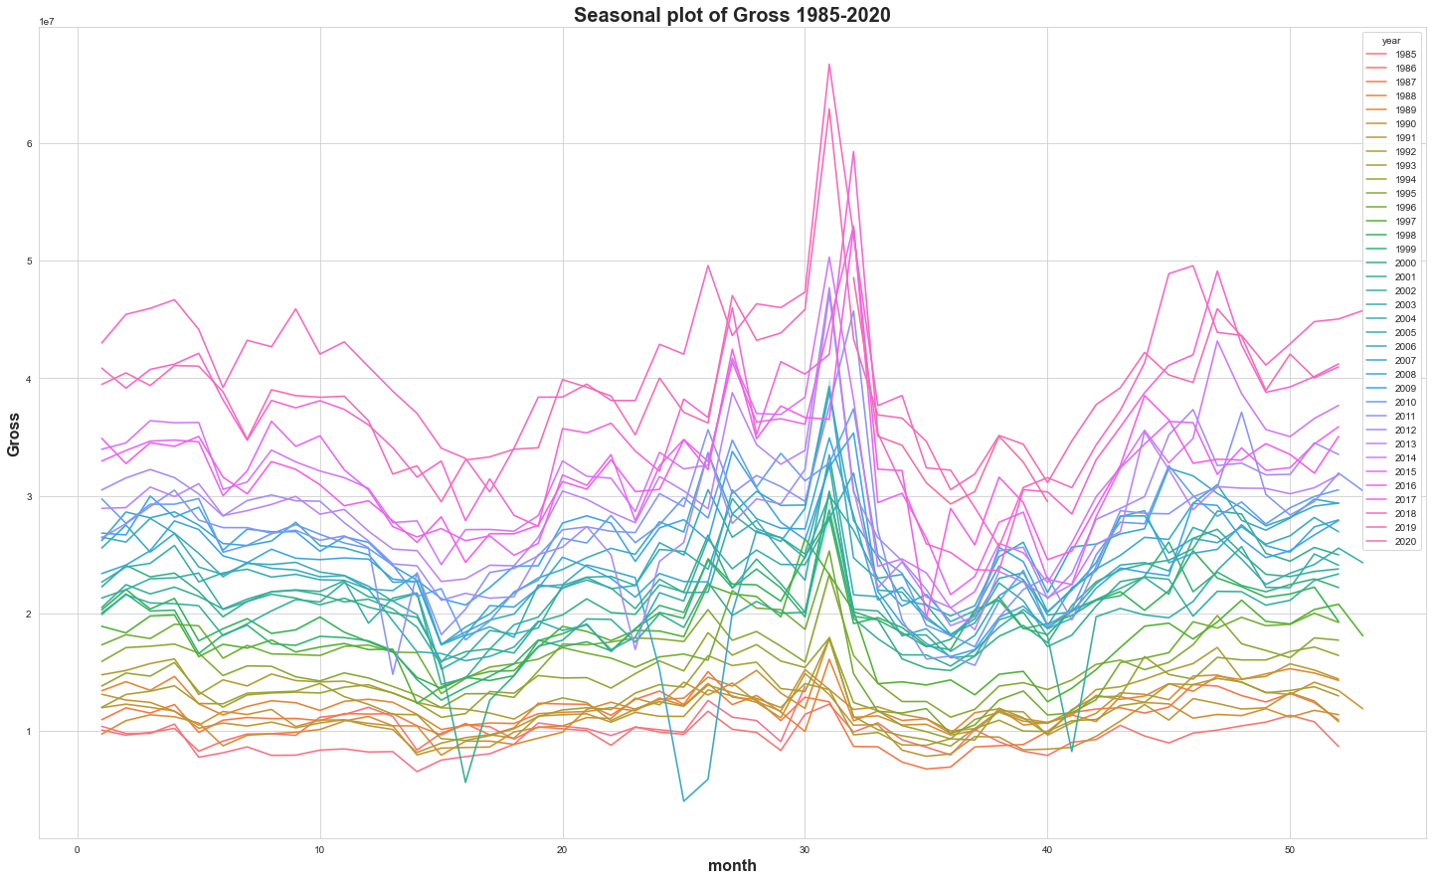
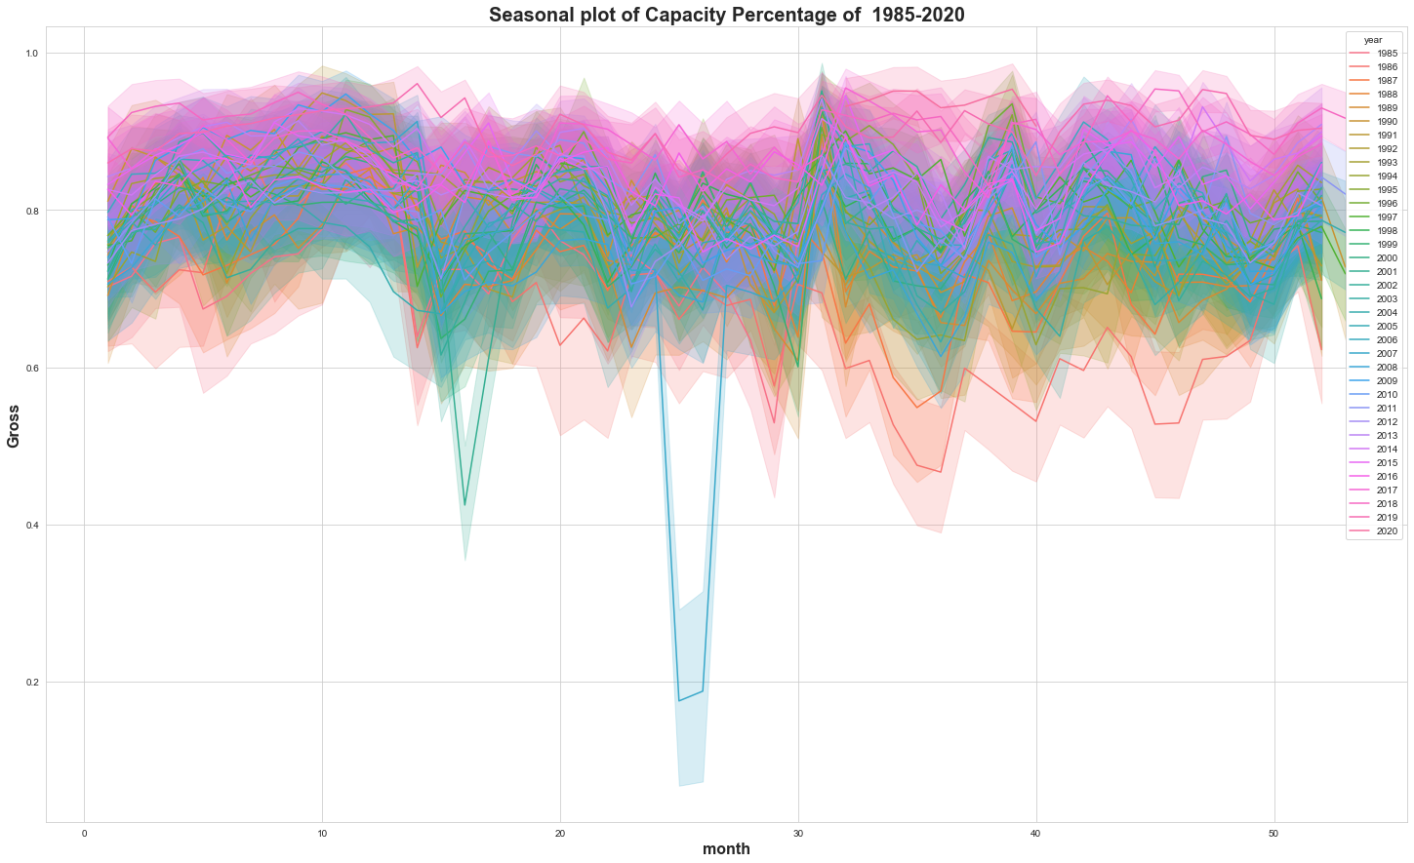
Exploratory data Analysis: Trends + Seasonality
A
C
B
D
Notes:
1. Price interval of the affordability of people by understanding the percentage capacity 2. Seasonal plots of the gross from 1985-2020 3. Seasonal plots of capacity percentage over the years 4. Seasonal plots of average ticket price every month from 1985-2020

Slide 8
Forecasts
ARIMA: Forecasting
ARIMA: Dynamic Forecasting
LSTM + Multiple Linear Regression
Prophet
Notes:
Which shows is the most preferred by the audience? Adding the contribution of majestic theatre to the entire broadway industry

Slide 9
Model Comparison
RMSE VALUES
 | ARIMA-FORECASTING | ARIMA-DYNAMIC FORECASTING | LSTM | MLR | PROPHET
Total Gross/Potential Gross | 0.04 | 0.1 | 0.105492 | 0.037487 | 12.503776
Average Ticket Price | 8.09 | 17.24 | 11.02593 | 8.556401 | 1824.676015
Seats Sold | 358.93 | 519.28 | 673.439724 | 436.492349 | 133495.0822

Slide 10
Key takeaways
TOP 2 percentile of Theaters Bring in more sales
The theaters that make up more than 2% of potential gross accounts for 68.318% of weekly actual gross of ticket sales in the Broadway Industry.
“tHE PHANTOM OF THE OPERA”
The show “The Phantom of the Opera” is the only show performed in the Majestic Theater. This makes the Majestic Theater one of the top five highest grossing theaters.
Best Grossing Show
Best grossing Theater
The best show that contributes the highest gross is “The Phantom of the Opera”
The best theater that contributes the highest gross in the Broadway Industry is the Broadhurst Theater.

Slide 11
Future directions
Improve Broadway dataset for large scale analysis
Be able to predict how the winning of a Tony award improves the business of investors

Slide 12
Acknowledgement:
We are grateful to our project mentor :
Amber Simmons, PhD
All the team members at the Erdós Institute, especially:
Prof. Roman Holowinsky
Matt Osborne, PhD

Slide 13
Thank you for your attention
Team Juno
Praveen Shahani
Gautam Prakriya
Michael Amoah Awuah
Moran Shechnick
Spring 2022 Bootcamp

